Slide 1
MARKETING ANALYTICS BUSINESS CASE I
Vincent Wilmet
Benjamin Karaoglan
Tabea Redl
Laure Dassy

Slide 2
Segmentation Analysis
QUESTION 1
We decided to focus our analysis of the population on four segments with a hierarchical classification.
Although a statistical perspective would choose only 2 segments, there are several factors that led us to pick four segments for our marketing analysis: (i) managerial usefulness, (ii) heterogeneity, (iii) segment distinctiveness and (iv) data completeness.
Comparing different segmentation analysis, we observe that the more segments we add, the lower is the accuracy of the predicted segments. [Table 1]
However, looking at the dendrograms, when the number of segments is small, we create important jumps which is why we picked 4 segments. [slide 3 Figures 1,2,3]
Segments | 2 | 3 | 4 | 5 | 6
Global Hit Rate | 70% | 71% | 58% | 46% | 41%
Table 1. Global Hit Rate by segment
(i) Managerial usefulness
More efficient processes
With more than 4 segments, managerial constraints appear
Targetability
Each segment presents a few but very distinct attributes which will help management tailor their program experience on these metrics

Slide 3
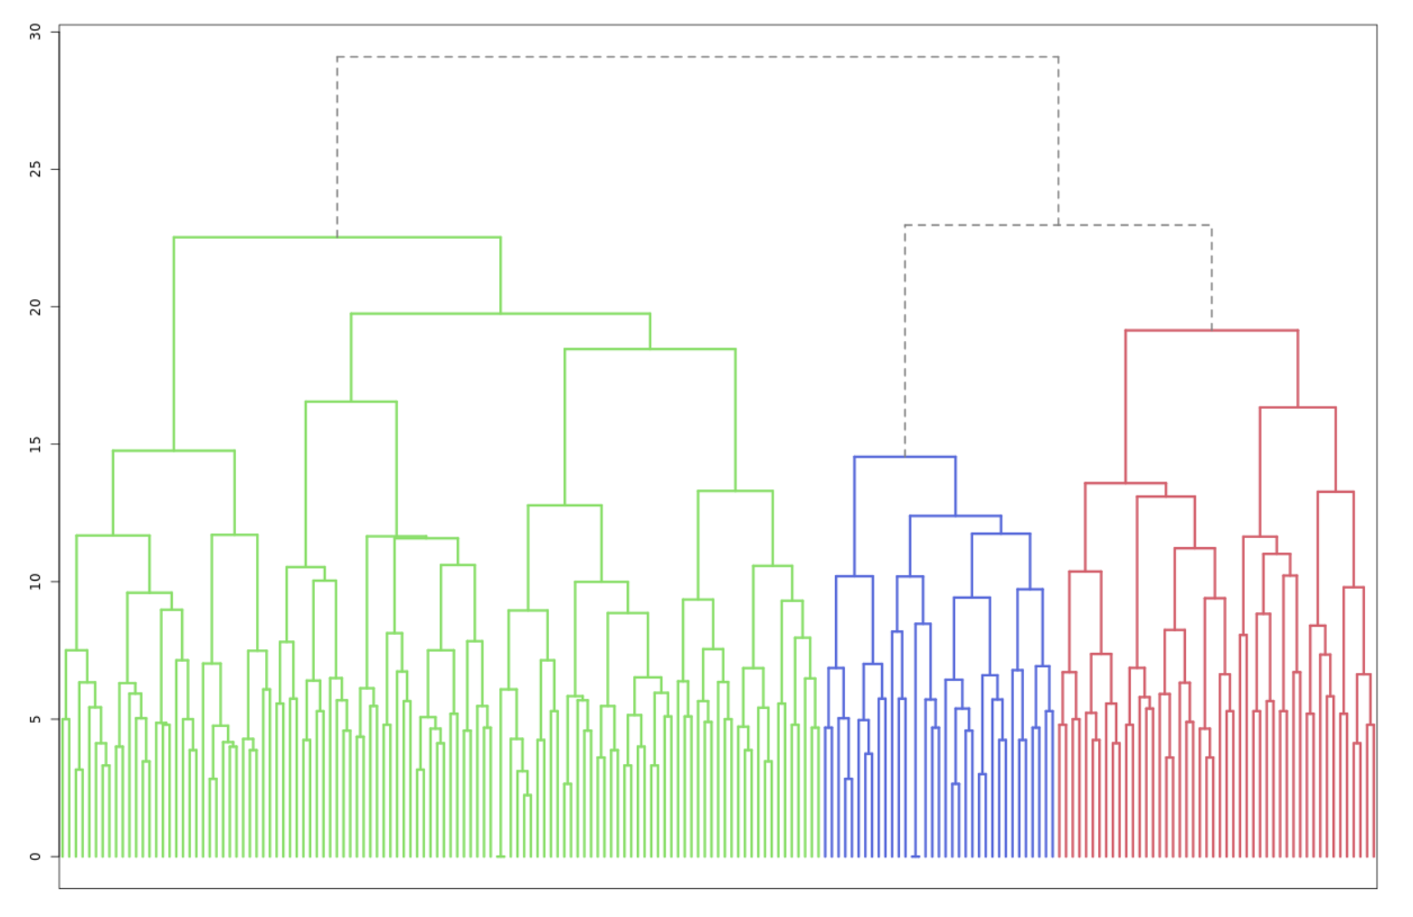
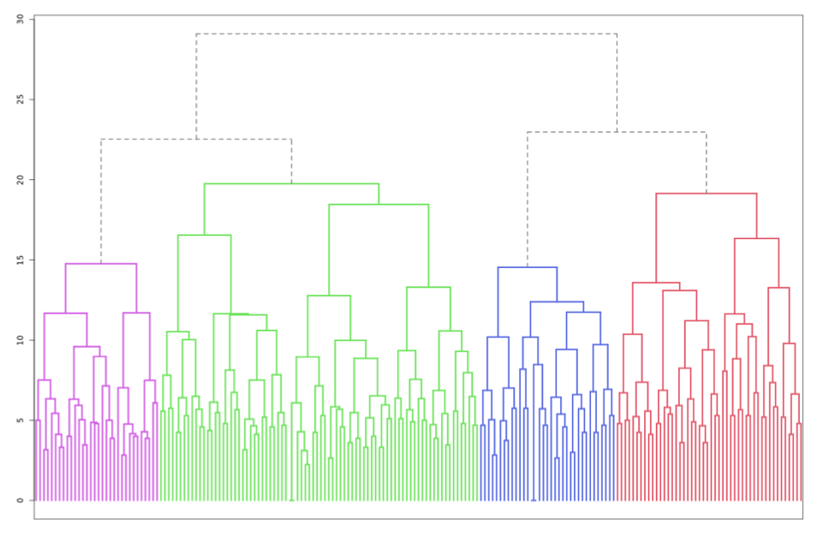
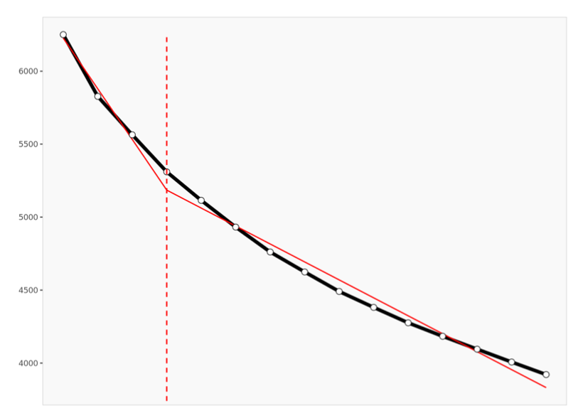
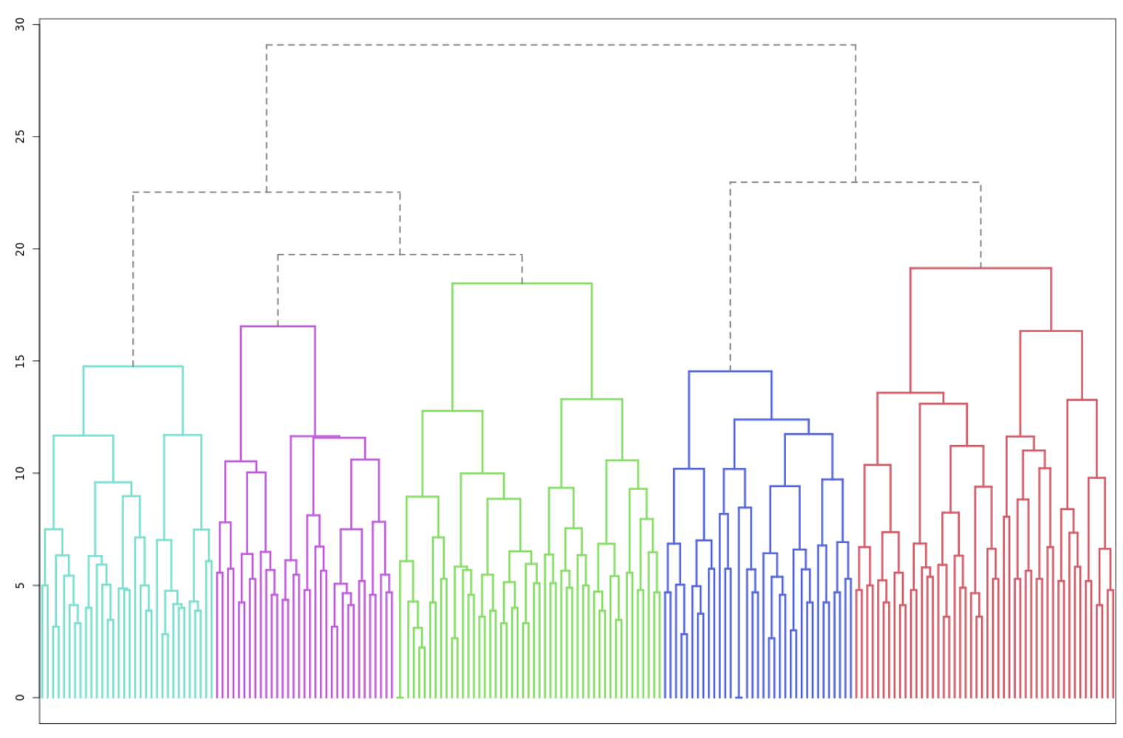
Segmentation Analysis
QUESTION 1
Figure 2. Dendrogram 3 segments
Figure 1. Dendrogram 4 segments
Figure 4. Scree plot
Figure 3. Dendrogram 5 segments
(ii) Heterogeneity
Between 3 and 4 the segments' heterogeneity within cluster decreases importantly [Figure 4]
Jumps for 4 segments are smaller than for 5 segments [Figure 1 and 5]

Slide 4
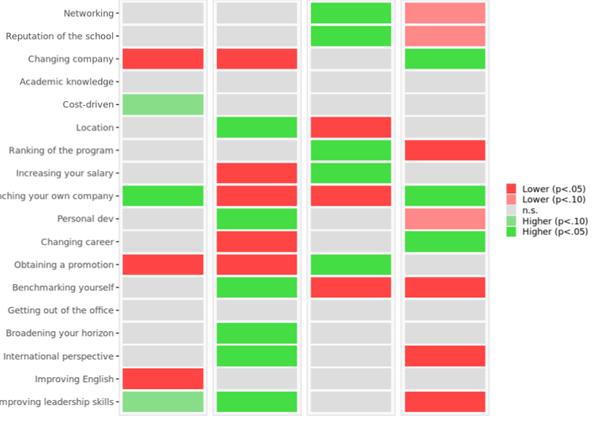
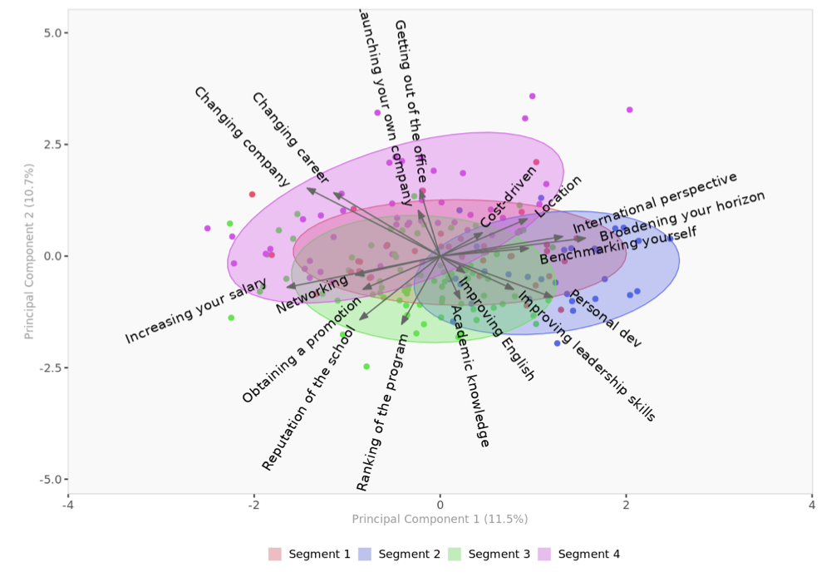

Segmentation Analysis
QUESTION 1
Segment 1
Segment 2
Segment 3
Segment 4
(iii) Segment distinctiveness
Analyzing Table 3 and 4, we conclude that four segments will be more effective to drive our analysis and derive a good understanding of the ambition of the candidates for joining the program
Example [Table 3]: No distinction between segment 2 and 3 with 3 segments. Here we see that one is more intellectual and the other more money-driven.
(iv) Data Completeness: Less outliers
Figure 4 presents less outliers than a three-segment space. We will be able to reach a higher % of the population with four segments.
Table 3. Segment differences per segment
Table 4. Segment size
Figure 4. Four segment space

Slide 5
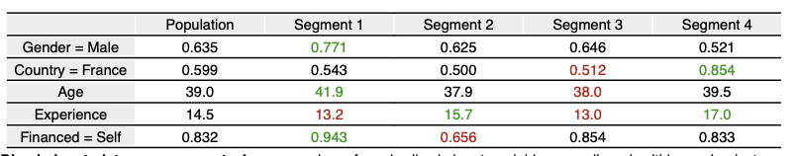
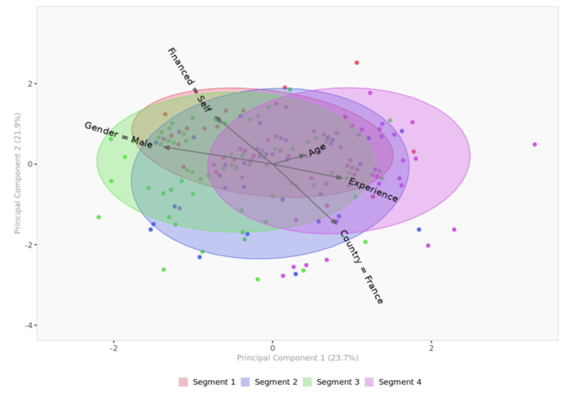
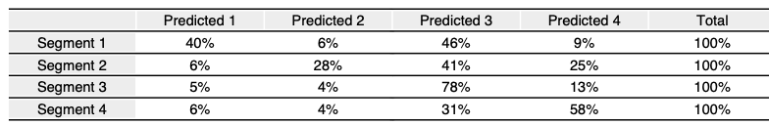




QUESTION 1
Discriminant & Confusion Data
Confusion space [Figure 6] Confirms that we need at least 3 segments as there is only one overlap between segment 1 and other segments.
Table 7. Discriminant data per segment
Figure 6. Confusion Space with 4 segments
We observe in table 7 that all segments seem to substantially differ one from another:
Segment 1: more males , self-financed than the others
Segment 2: more experience but less self-financed than the average
Segment 3: less professional experience
Segment 4: more French population and the most experience
Confusion matrix [Table 8]
Helps us assess the quality of segment discrimination and reassures us in choosing 4 segments as the matrix indicates that segment 1 is 40% accurate and segment 3 differs a lot from segment 1.
Table 8. Confusion Matrix

Slide 6
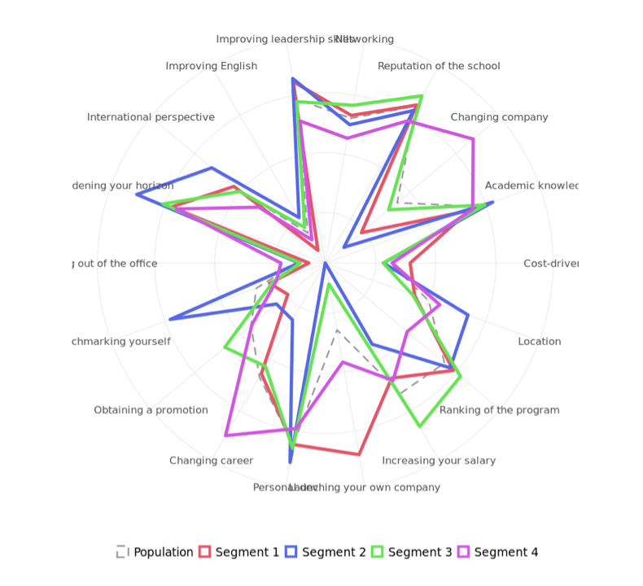
Who Are We Targeting?
QUESTION 2
Drawing from the segmentation variables and analysis, the discriminant & confusion data, we categorized our population into 4 segments.
The spider chart was used to compare the different segments and help build each personas’ attributes.
From our analysis we noted key differences that can be found in the description of each persona.
Figure 3. Spider Chart with 4 segments

Slide 7

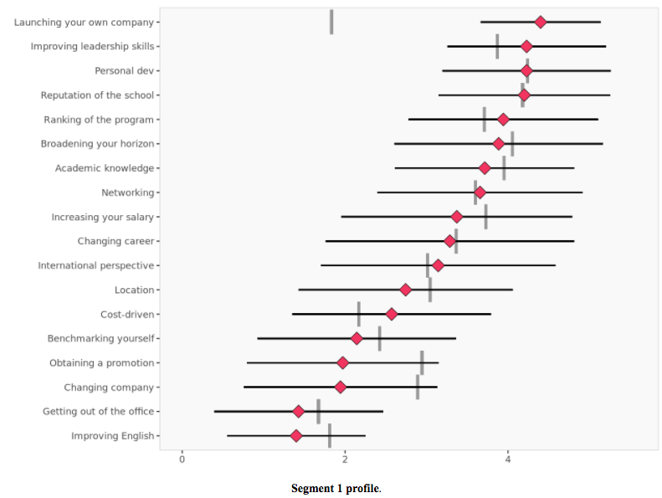
QUESTION 2
Segment 1 Persona:
Richard, the soon-to-be successful startup founder
﻿
Profile icon
Richard has so far led a successful career. He’s a confident 42-year-old male who believes that he has all the assets and capacities required to become the next Thomas Siebel. He’s willing to invest his money in education in order to acquire the knowledge he believes would be crucial to the success of the startup he’s planning to launch. Richard believes in himself but is rational enough to understand that an EMBA such as the one offered by l’ESSEC could drastically influence his leadership-skills and improve his chances of success when launching his company.
Descriptors:
Gender: Male
Nationality: French
Age: 42
Years of experiences: 13
Self-financed
Richard's most important variables for an EMBA:
-Launching your own company: 5/5
-Improving leadership-skills: 4/5

Slide 8
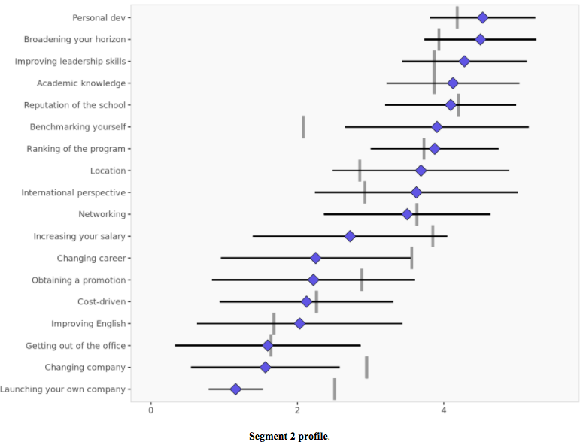
Segment 2 Persona:
Jacob, the introspective worker
QUESTION 2
Profile icon
Jacob is an expert in his field. He spent a lot of time working in the same industry, and after many years of work, he knows precisely what he needs to improve himself. Jacob believes that that an EMBA could possibly give him an international perspective insofar as the program is based abroad. More importantly, with the financial help of his company, Jacob considers that an EMBA could be the missing piece to his intellectual baggage. He believes that conducting such a program would only better his professional skills but would also improve his capabilities and potential in every aspect.
Descriptors:
Gender: Male
Nationality: USA
Years of experience: 16
Financed by his company
Jacob's most important variables for an EMBA:
-Personal dev 5/5
-Broadening your horizon: 5/5
-Improving leadership skills: 4/5
-Benchmarking yourself 4/5
-Location: 4/5
-International perspective : 4/5

Slide 9
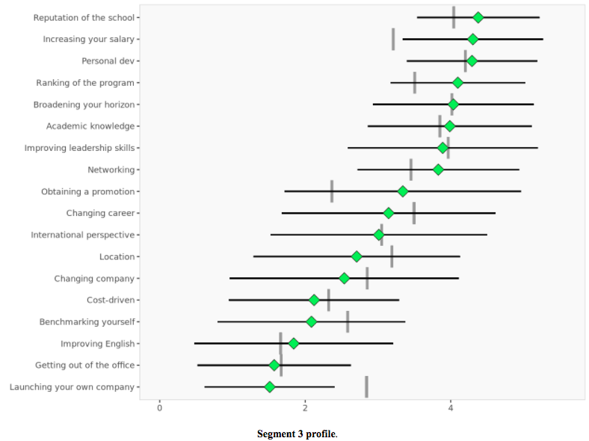
QUESTION 2
Segment 3 Persona
William, the typical EMBA applicant
Profile icon
William is the most common EMBA applicant. He’s a bit younger and a bit less experienced than other applicants, but this isn’t what makes him different from the others. Indeed, the difference lies within his ambitions. William wants more, but not on an intellectual, spiritual or meaningful level. William simply wants more on a professional and financial level. William wants an EMBA that will give him access to a promotion, a great network, and more importantly for him, an increase of his salary. William will choose an EBMA that is extremely well ranked, but even more importantly, offered by a prestigious school.
Descriptors:
Gender: Male
Nationality: British
Age: 38
Years of experience: 13
Self-financed
William's most important variables for an EMBA:
-Reputation of the school 5/5
-Increasing your salary 5/5
-Ranking of the program 4/5
-Networking 4/5
-Obtaining a promotion 3/5

Slide 10
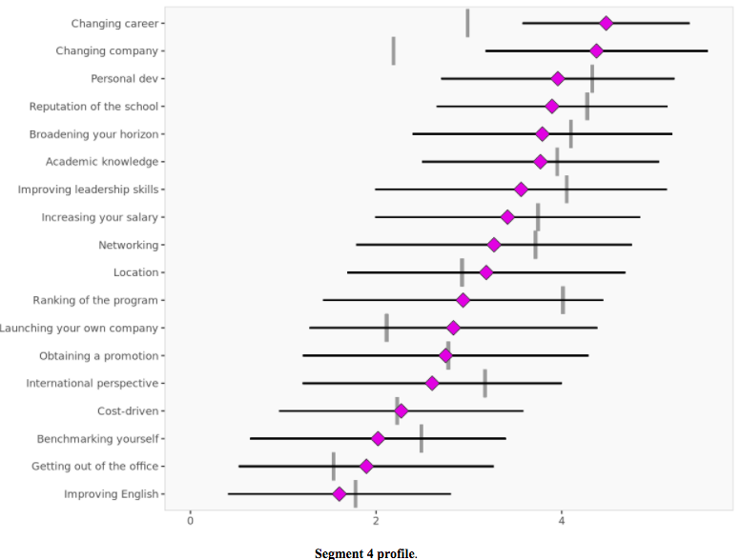
Segment 4 Persona
Camille, the fed-up expert
QUESTION 2
Profile icon
Camille has been working hard as an engineer for the past 17 years, the majority of which spent for the same company under the same position. Camille was born and raised in France and has never truly explored other horizons, geographically or professionally. However, she feels that she has gained enough experience in her field of expertise at the same company for over a decade to work on management. Therefore, Camille is ready for change and wants to turn her life around. She wants to onboard the EMBA program in order to gain the tools required for her to change her career path and quit her company.
Descriptors:
Gender: Female
Nationality: French
Age: 40
Years of experience: 17
Self-financed
Camille's most important variables for an EMBA:
Changing career 5/5
Changing company 4/5

Slide 11
Recommendations for EEE Management – Persona 1
QUESTION 3
Module
Entrepreneurship & Innovation
Entrepreneur- ship, innovation and leadership courses
Meet a potential co-founder
Launch a project such as building a start-up/ hackathon
Access to alumni and investors
Richard
Extra help to access l'ESSEC Ventures incubator
"Pioneering Spirit"
ESSEC's motto. We are all about "the start-up mentality."

Slide 12
Recommendations for EEE Management – Persona 2
QUESTION 3
Module
Personal dev & Broadening horizon
Classes on leadership, international topics and wellness
Research at ESSEC & in cooperation with companies
Exposure to international students and cultures
Singapore Campus and Mannheim Partnership
Jacob sees a promising factor in the international dimension of the program.
Jacob
Join diverse array of associations
"Pioneering Spirit"
ESSEC's motto. We are all about "exploring the world's unknown."

Slide 13
Recommendations for EEE Management – Persona 3
QUESTION 3
Module
Money and Power
Negotiation, leadership and economics classes
Ranking of the school
Find likeminded people to network with
Seminars with successful ESSEC alumni
William
Alumni success stories
"Pioneering Spirit"
ESSEC's motto. We are all about "rising above the rest."

Slide 14
Recommendations for EEE Management– Persona 4
QUESTION 3
Module
Discover a new career-path / fresh start
Opportunity to catch breath and focus on the career you want to pursue
Recruitment events, career fairs
Classes to prepare for the field you want to pursue
Introductions to alumni who are hiring
Camille
Interview and CV workshops
"Pioneering Spirit"
ESSEC's motto. We are all about "finding the inner strength to explore new paths."

Slide 15
Recommendations for the Sales Team
QUESTION 4
Identify which segment an applicant belongs to
If cannot identify the segment, go with the most general strategy which is those of segment 3
After having identified the applicant, promote the key factors which are summarized below.
Segment 1 - Richard
Segment 2 - Jacob
Entrepreneurial focus
ESSEC Ventures Incubator
Networking with Alumni and Investors
International dimension
Expertise of teachers
Personal development possibilities
Segment 3 - William
Segment 4 - Camille
Prestige of the school
Successful Testimonials
Leadership Expertise
Recruitment support
Strong company relations
Management Expertise

Slide 16
Limitations to the use of the segmentation survey
QUESTION 4
Discriminant analysis should not be used by the recruiting team (could create a bias for nationality, gender, etc.)
Other advice:
Budget should not necessarily be allocated proportional to the segment size
Do not focus solely on one segment
Not every applicant might be clearly in one segment or another
Candidates may not be truthful in their answers (projected persona)

Slide 17
Thank You for your time.

Slide 18
APPENDIX

Slide 19
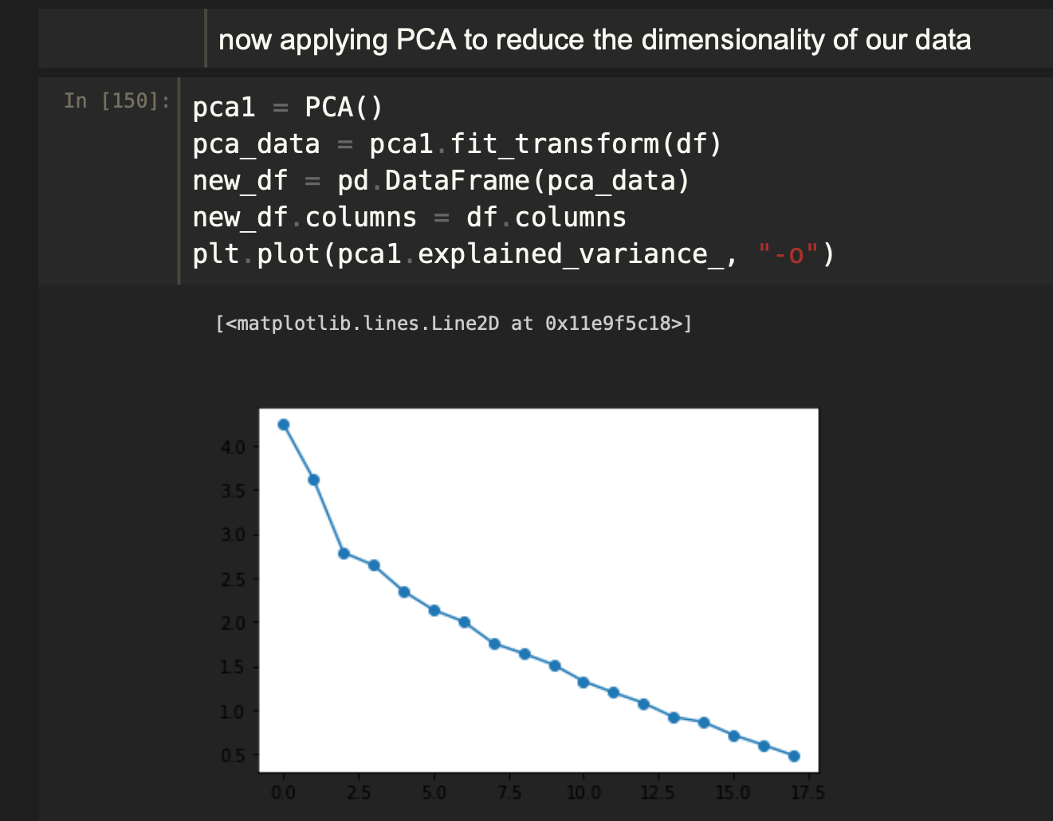
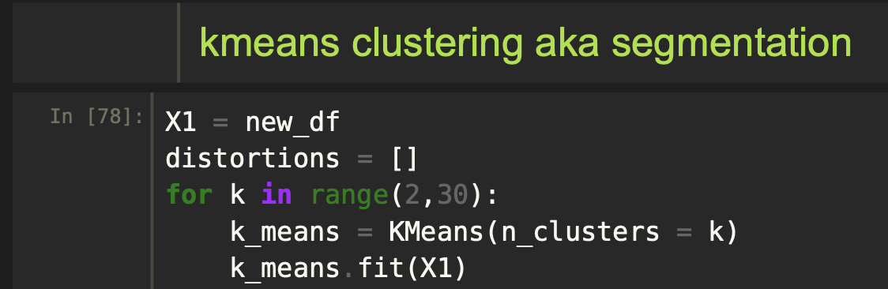
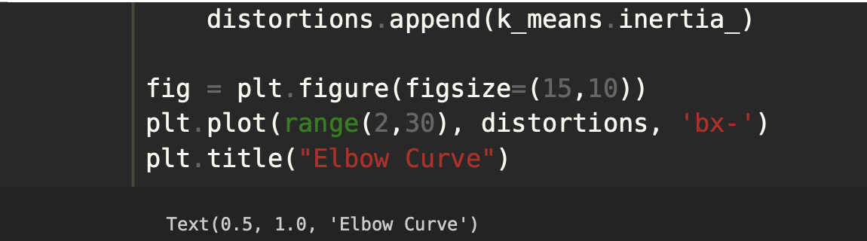
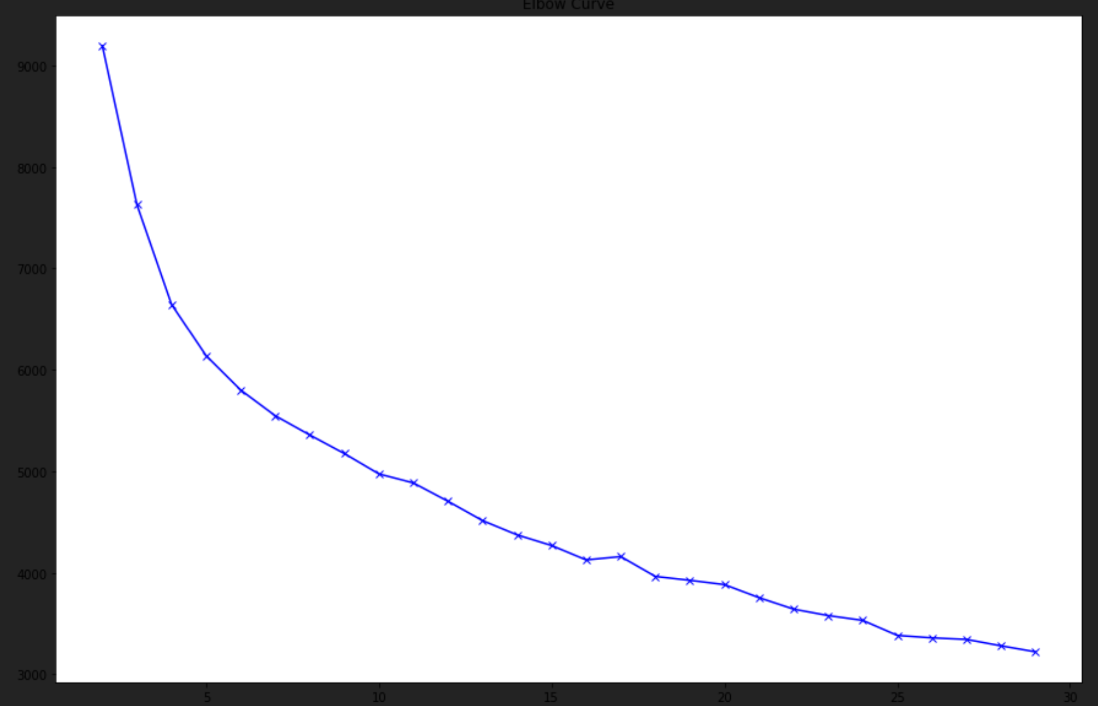
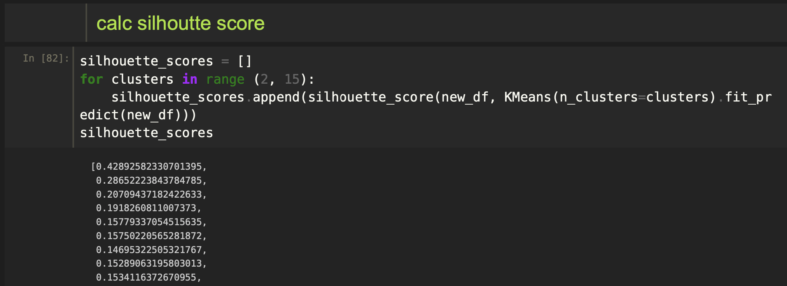
Appendix 1. Ran analysis on Python
We found that running an analysis on our data in python produced similar results to enginius, where the optimal number of clusters or silhouette scores (segments) we chose were 4.
Scree Plot
Elbow Curve

